Slide 1
Science Skills and Introduction to Statistics
HYPOTHESIS TESTING
Module Code: STAT101
Module Leader: Farzana Rahman
Office: GE201
Email: f.r@institute.ac.uk

Slide 2

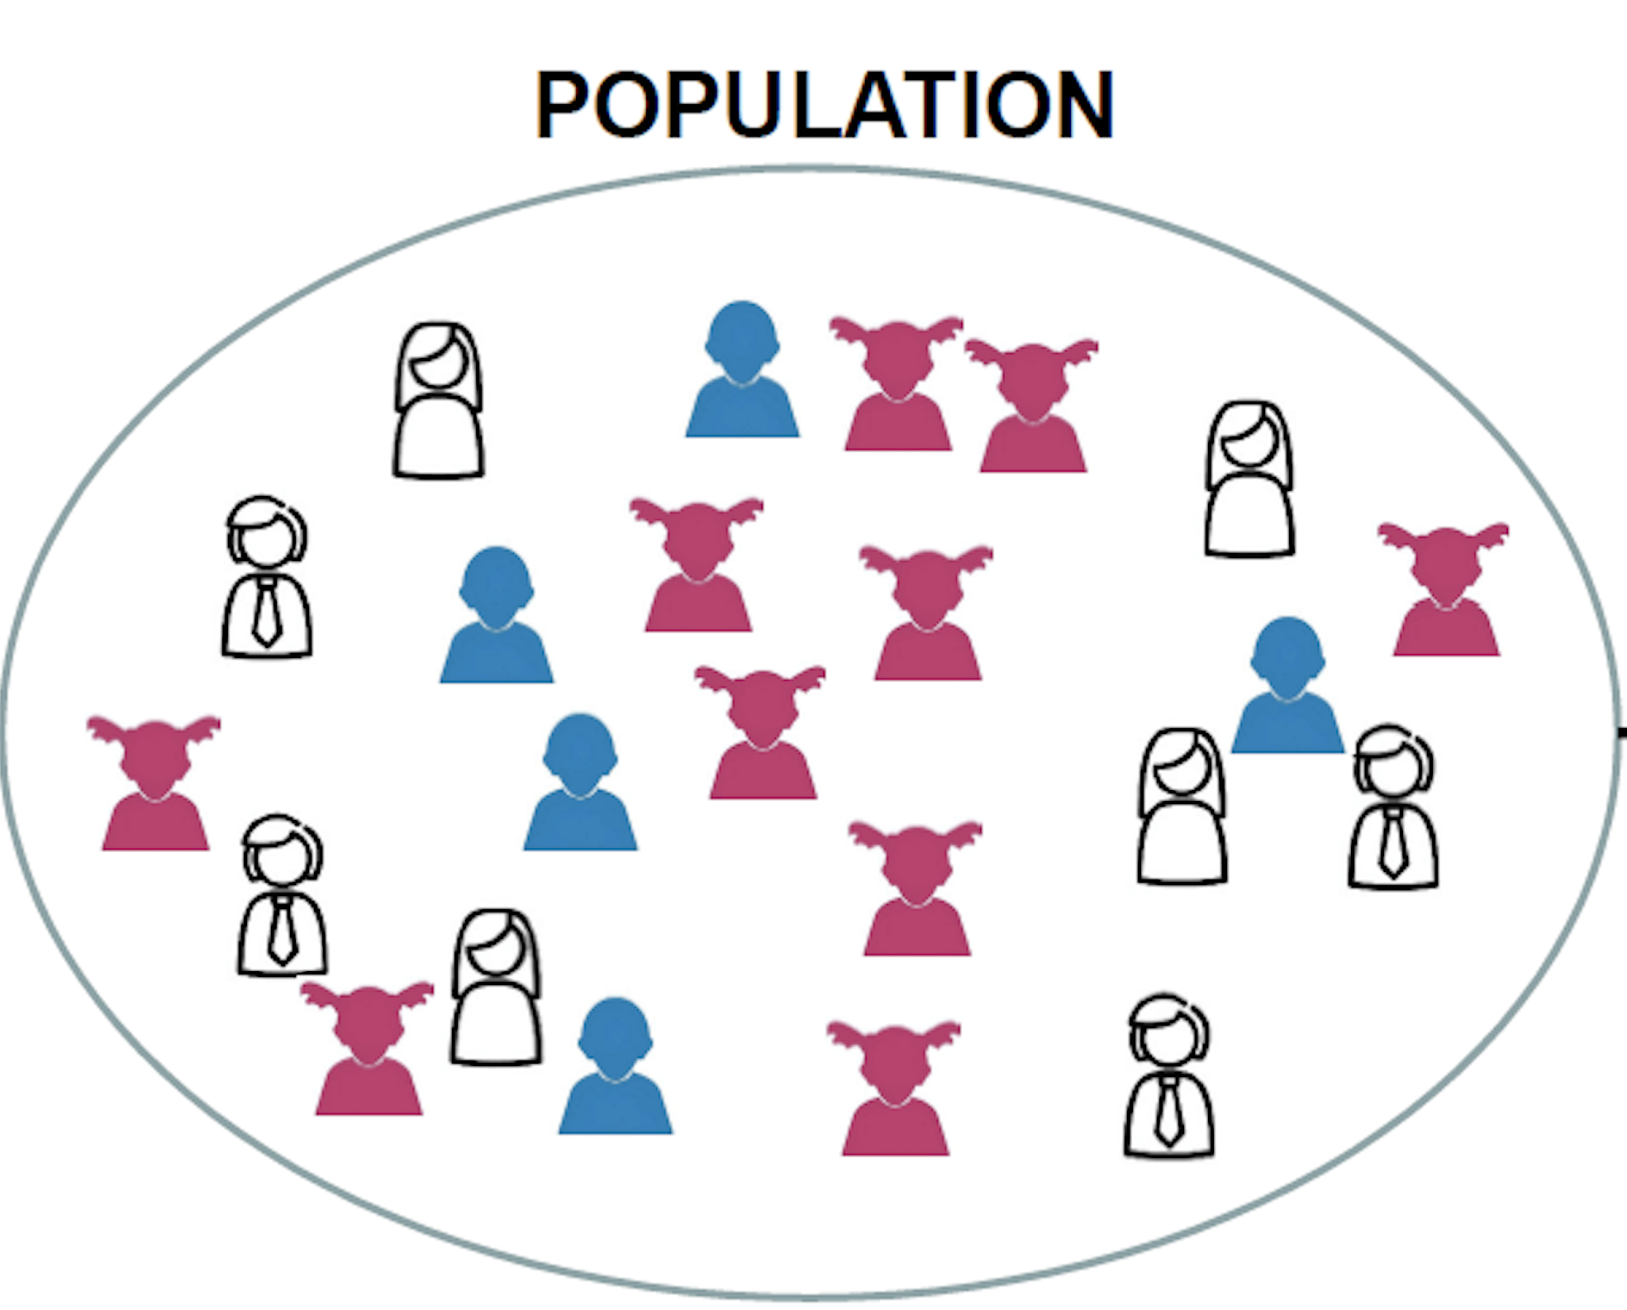
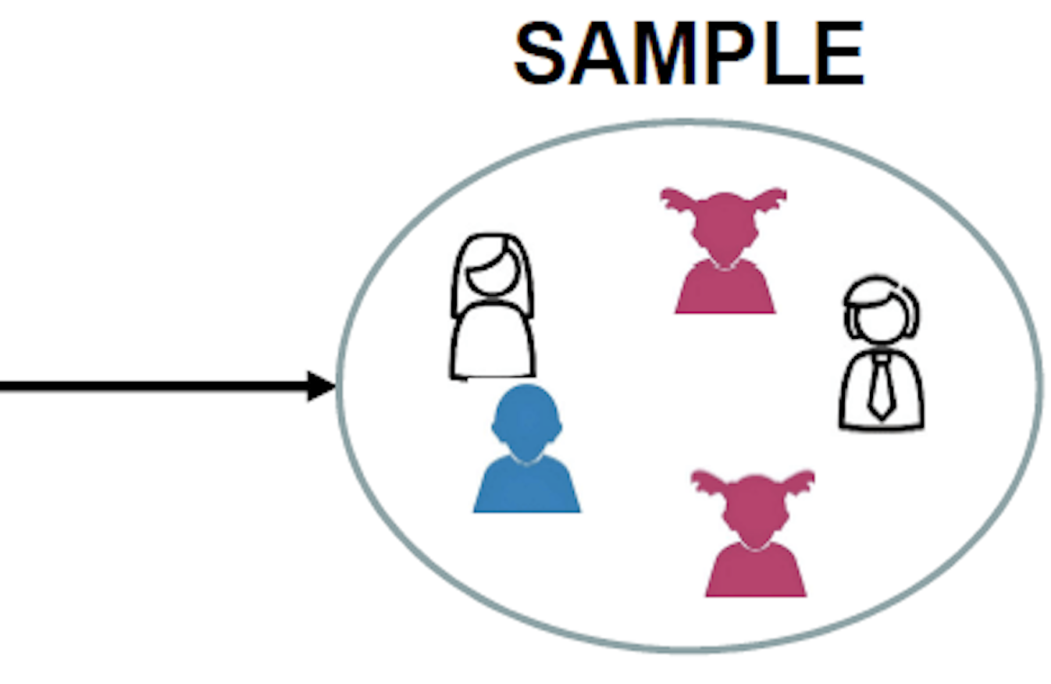

Hypothesis
What is it?
Hypothesis testing
POPULATION
SAMPLE
Notes:
A hypothesis testing is a key procedure in inferential statistics. It is based on the idea that we can tell things about a population by taking a sample from it. For example, if we go to an orchard and want to know if the apples in that orchard taste , good or bad, we cannot eat all the apples to tell that! Rather we can take a sample and try the apples to decide taste of apples in that orchard. …

Slide 3
Hypothesis testing
Hypotheses
Significance
Sample
P-value
Decision

Slide 4





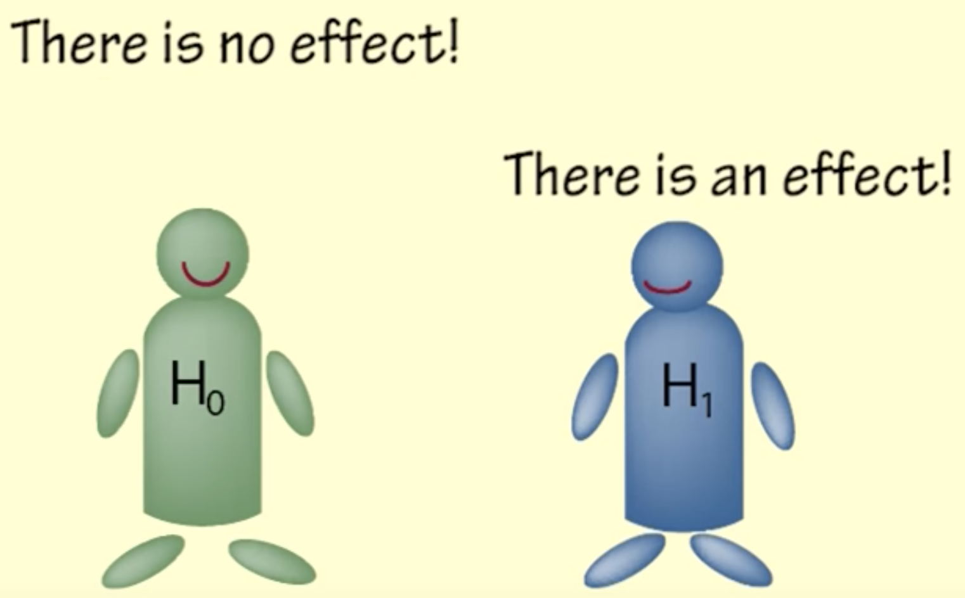
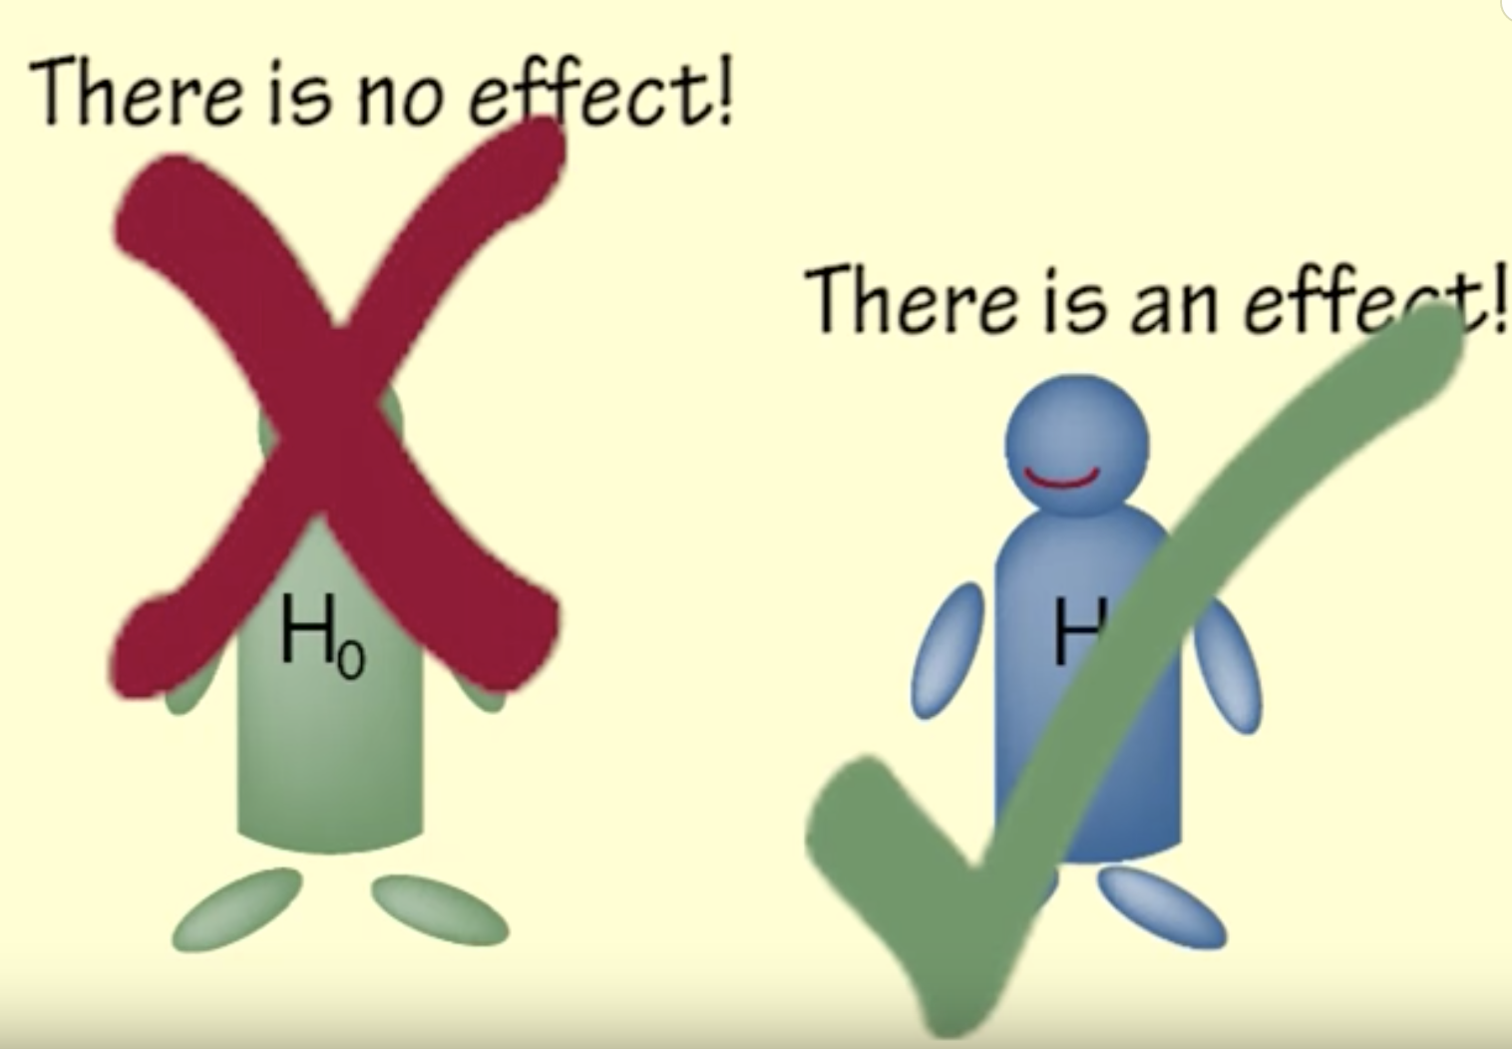

Hypothesis testing
Hypotheses
Null Hypothesis, H₀
Alternative Hypothesis, H₁ or H_{A}
Notes:
Step one Hypotheses. We need null hypothesis and alternative hypothesis. Inferential statistics is based on the premise that we cannot prove something to be true, but we can disprove it by finding an exception to it. You decide what you are trying to provide evidence for, that is alternative hypothesis and set up the opposite as null hypothesis and find evidence to disprove it. It may seem that we are usually trying prove the alternative hypothesis while the null is the opposite or status quo.

Slide 5
Hypothesis testing
Hypotheses Notes
Hypothesis is about population parameters
Null Hypothesis (H₀) generally represents no effect
H₀ includes equality (= or ≤ or ≥), H₁ does not.
Notes:
Hypotheses test is all about the population parameters not about the sample values, Null hypothesis refers to the status quo as it means we are trying to find evidence against and it generally represents no effect. Null hypothesis should include a statement of equality and alternative hypothesis should not.

Slide 6


Hypothesis testing
2. Level of significance
⍺ = 0.05
You are wrong
You are correct
3. Sample
Notes:
Step two significance. Decide on your significance unless there is a reason not to. Generally significance is considered 0.05 ( which means 95% confident) and is denoted by alpha. Significance is the probability that says the null hypothesis is wrong, which is actually true, this is known as type I error.
Step 3: Take a sample from the population to decide on the statistics of the population.

Slide 7
Hypothesis testing
4. P-value
If the null hypothesis was true, the sampling variation will produce an estimate further away from the hypothesised value.
5. Decision
Accept or Reject the hypothesis
If P-value < ⍺ (Reject H₀)
If P-value > ⍺ (Accept H₀)
Notes:
The p-value is the probability that if the null hypothesis was true, the sampling variation will produce an estimate further away from our hypothesised value than our data estimate. In simple terms, P value tells us how likely it is to get a result like this if the Null hypothesis was true.
Based on the p value decide on the result. If the P value is less than the level of significance, null hypothesis is rejected

Slide 8
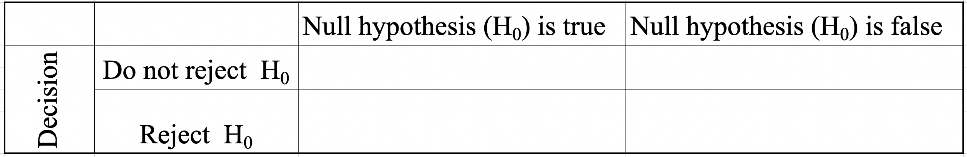
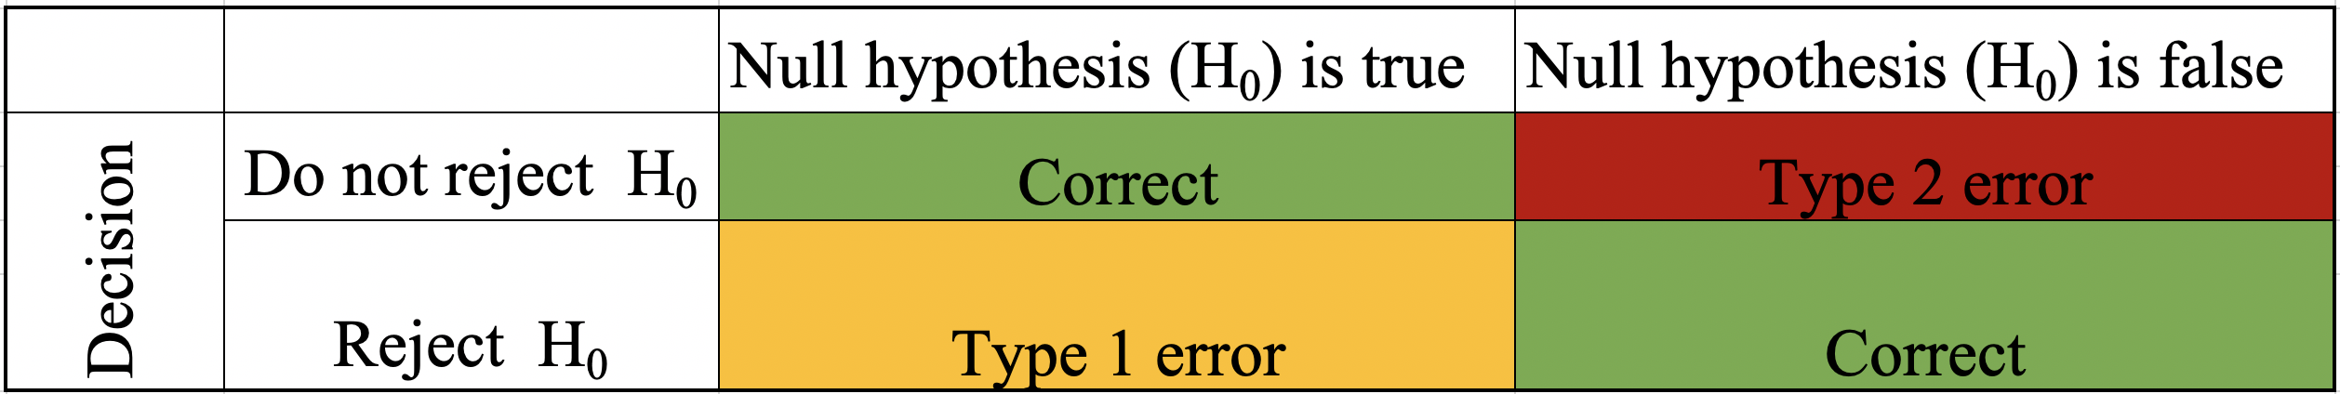
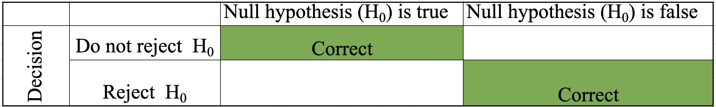
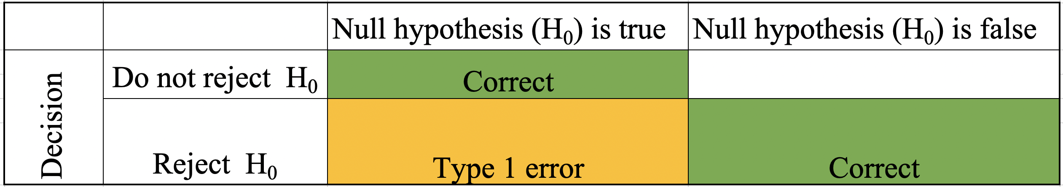
Hypothesis testing: Error Type
Reality ( unknown)
Notes:
In reality we can never know if our decision will be right or wrong as error may occur. There are two types of error. Type I and type II. In Reality we can either say null hypothesis is true or null hypothesis is wrong. Based on our statistical test we can decide either to reject H0 or not to reject H0.
Type I is when we say there is an effect when there is not.
Type II when we fail to find an effect that exists .

Slide 9
Hypothesis testing: T- test
What is a t-test?
“Significant difference between the means of two groups.”
Types of t-test:
One sample test
Two sample test
Independent (unpaired)
Dependent (paired)
Notes:
T-test is a statistical test that checks the significant difference between the means of two groups. The significant difference mean that the results are seen are mostly not likely due to sampling error. in any experiment or observation that involves sampling from a population, there is always the possibility that an observed effect would have occurred due to sampling error alone. But if result is "significant," then we may conclude that the observed effect actually reflects the characteristics of the population rather than just sampling error or chance.
One sample t test: We use one sample t-test when we have one type of population and we want to see if the population mean is significantly different to the hypothesised mean.
Two sample independent: Two populations who are independent. Comparing the mean response of two groups of patients on treatment VS control in a clinical trial.
Two sample dependent : Comparing the blood pressure of patients before and after treatment

Slide 10
Hypothesis testing: One Sample T-test
Q 1: A microarray supplier claims that their microarray failure rate is 2.1%. A lab would like to know whether this reflects the failure rates that they’ve observed over the last 12-months, so they have collected failure rate data on a monthly basis.
 | Month | Failure ( %)
1 | January | 2.90
2 | February | 2.99
3 | March | 2.48
4 | April | 1.48
5 | May | 2.71
6 | June | 4.17
7 | July | 3.74
8 | August | 3.04
9 | September | 1.23
10 | October | 2.72
11 | November | 3.23
12 | December | 3.40
Hypothesis
Significance
Sample
P-value
Decision
Null hypothesis: Mean monthly failure rate = 2.1%
Alternative hypothesis: Mean monthly failure rate ≠ 2.1%
Two-tail test
Significance level, ⍺ = 0.05

Slide 11

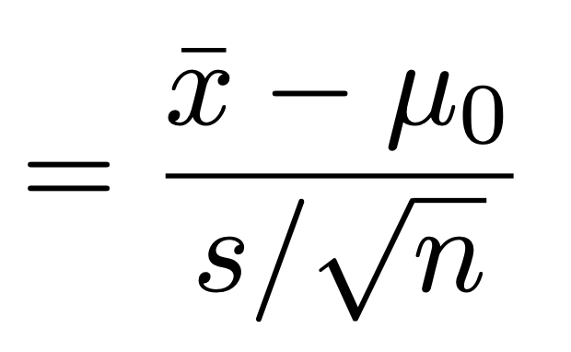
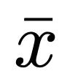
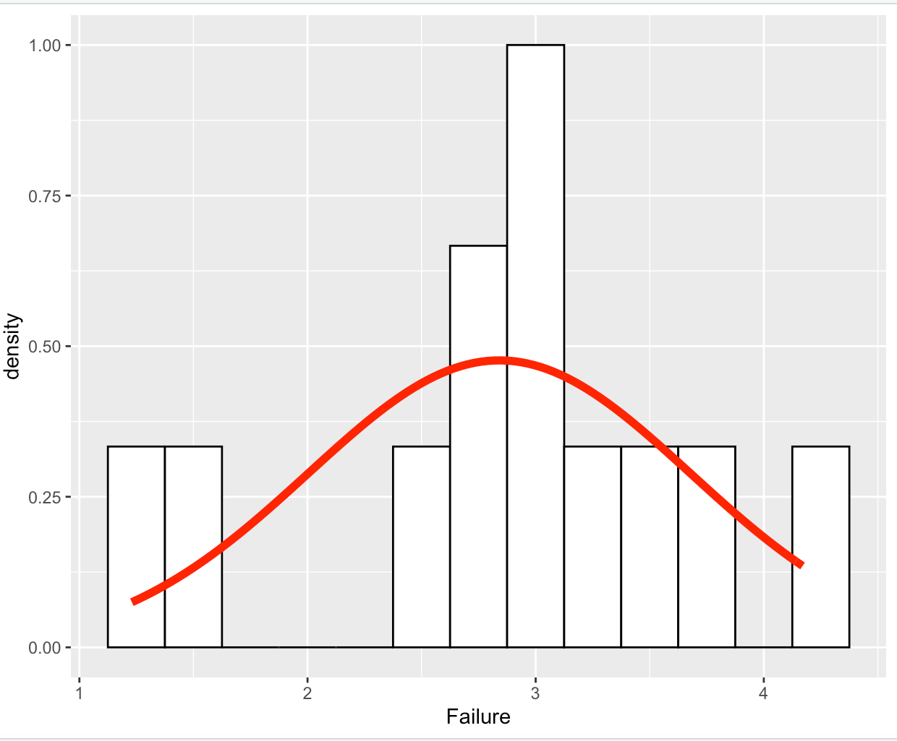

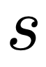
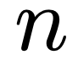
Hypothesis testing: One Sample T-test
The one sample t-test is based on the formula:
Where, is the sample mean
is the hypothesised mean
is the sample standard deviation
is the sample size
Notes:
Key points to decide one sample test: 1. The observations are independent 2. The observations are normally distributed. Here the data are normally distributed

Slide 12
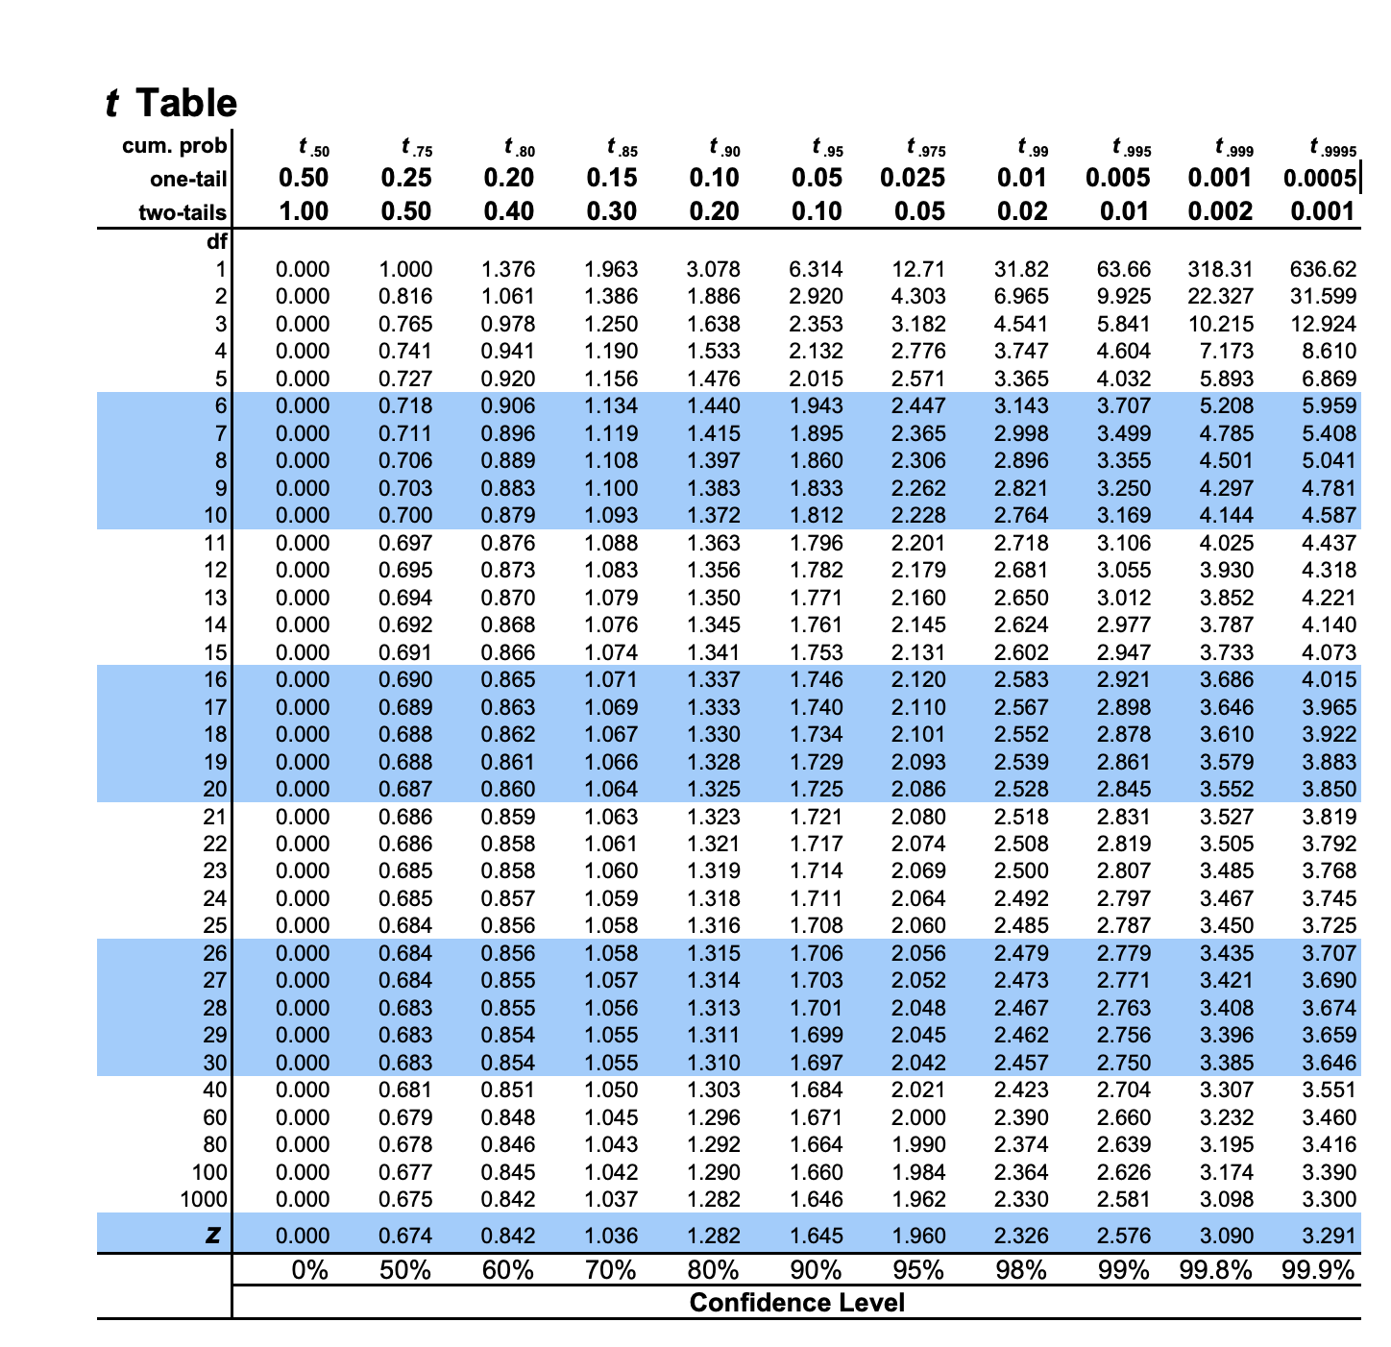
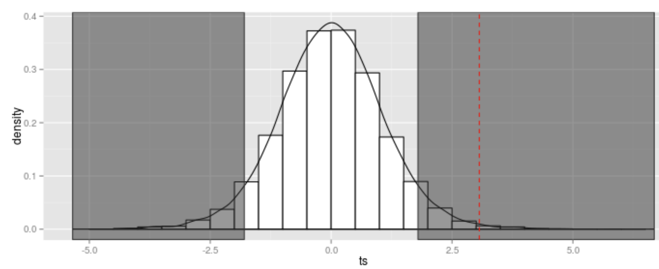
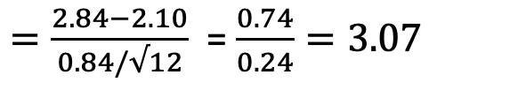
 | Month | Failure %
1 | January | 2.90
2 | February | 2.99
3 | March | 2.48
4 | April | 1.48
5 | May | 2.71
6 | June | 4.17
7 | July | 3.74
8 | August | 3.04
9 | September | 1.23
10 | October | 2.72
11 | November | 3.23
12 | December | 3.40
Hypothesis testing: One Sample T-test
The one sample t-test is based on the formula:
$=\frac{2.84−2.10}{0.84/√12}$ = $\frac{0.74}{0.24}=3.07$
Degrees of freedom = n-1 = 12-1 =11
P-value 0.01 < 0.05, therefore reject the null hypothesis.
Therefore, there is evidence to suggest that the failure
rate of the microarrays from this supplier is not 2.1%.

Slide 13
Hypothesis testing: Two Sample T-test
Q2. A researcher is interested in the effect of breed on weight in 4 week old male mice. 40 male mice were used, 20 of breed A and 20 of breed B.
Null hypothesis:
Mean weight of breed A = Mean weight of breed B
Alternative hypothesis:
Mean weight of breed A ≠ Mean weight of breed B
Two-tail test
 | Breed | Weight | Breed | Weight
1 | A | 20.77 | B | 15.51
2 | A | 9.08 | B | 12.93
3 | A | 9. | B | 11.5
4 | A | 8.13 | B | 16.07
5 | A | 16.54 | B | 15.51
6 | A | 11.36 | B | 17.66
7 | A | 11.47 | B | 11.25
8 | A | 12.1 | B | 13.65
9 | A | 14.04 | B | 14.28
10 | A | 16.82 | B | 13.21
11 | A | 6.32 | B | 10.28
12 | A | 17.51 | B | 12.41
13 | A | 9.87 | B | 9.63
14 | A | 12.41 | B | 14.75
15 | A | 7.39 | B | 9.81
16 | A | 9.23 | B | 13.02
17 | A | 4.06 | B | 12.33
18 | A | 8.26 | B | 11.9
19 | A | 10.24 | B | 8.98
20 | A | 14.64 | B | 11.29
Hypothesis
Significance
Sample
P-value
Decision
Significance level, ⍺ = 0.05

Slide 14
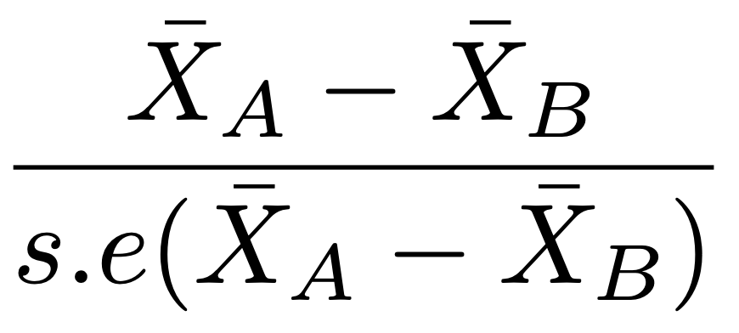
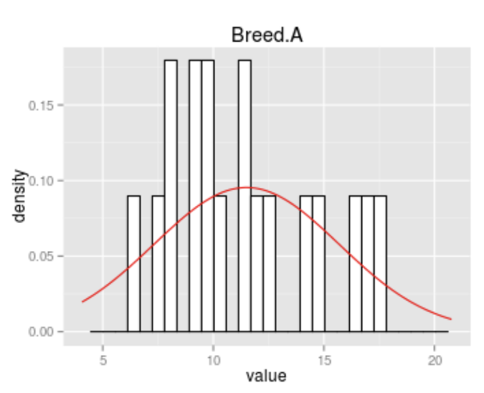
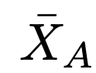
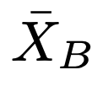
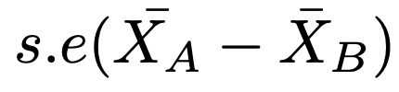
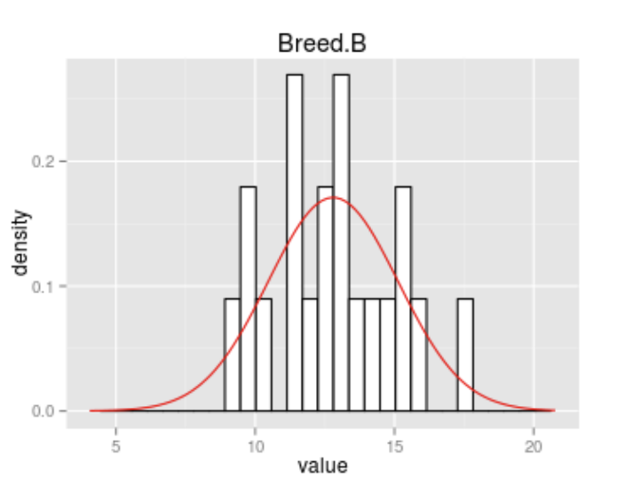
Hypothesis testing: Two Sample T-test
The formula of the independent two-sample test is , =
Where is the mean weight of mice in breed A.
is the mean weight of mice in breed B
is the standard error of
the difference in mean weights
In this case, df, the degrees of freedom is equal
the total number of mice (breed A and breed B)
minus the number of independent groups (N -2)

Slide 15
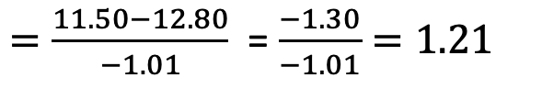
Hypothesis testing: Two Sample T-test
The formula of the independent two-sample test is , =
 | Breed | Weight | Breed | Weight | Differences
1 | A | 20.77 | B | 15.51 | 5.26
2 | A | 9.08 | B | 12.93 | -3.85
3 | A | 9.80 | B | 11.50 | -1.70
4 | A | 8.13 | B | 16.07 | -7.94
5 | A | 16.54 | B | 15.51 | 1.03
6 | A | 11.36 | B | 17.66 | -6.30
7 | A | 11.47 | B | 11.25 | 0.22
8 | A | 12.10 | B | 13.65 | -1.55
9 | A | 14.04 | B | 14.28 | -0.24
10 | A | 16.82 | B | 13.21 | 3.61
11 | A | 6.32 | B | 10.28 | -3.96
12 | A | 17.51 | B | 12.41 | 5.10
13 | A | 9.87 | B | 9.63 | 0.24
14 | A | 12.41 | B | 14.75 | -2.34
15 | A | 7.39 | B | 9.81 | -2.42
16 | A | 9.23 | B | 13.02 | -3.79
17 | A | 4.06 | B | 12.33 | -8.27
18 | A | 8.26 | B | 11.90 | -3.64
19 | A | 10.24 | B | 8.98 | 1.26
20 | A | 14.64 | B | 11.29 | 3.35
 |  | 11.50 |  | 12.80 | se= -1.01
$=\frac{11.50−12.80}{−1.01}$ = $\frac{−1.30}{−1.01}=1.21$
Degree of freedom, df =20+20-2=38
P-value 0.24 > 0.05, therefore this is not a
significant result as there is no evidence of a difference
in the weight of male mice at 4 weeks old between
Breeds A and B.

Slide 16

Have your say!
Provide today’s lecture at:
https://bit.ly/2LLEfnd

